Slide 1
ECCS 1721 Digital Logic
Serial Communication

Slide 2
SERIAL COMMUNICATION
So far our hardware descriptions have had inputs of 16 bits or less.
Modern computers and devices have word sizes of 32 or 64 bits.
Almost any practical application requires the transmission of an arbitrary amount of data.
If you want to transfer a gigabyte of data to your friend quickly, how do you do it?
Having one wire for each bit means you would have around 1 billion wires, which is impractical from both a physical and financial point of view.
Many different serial communication protocols have been invented to address the shortcomings of parallel communication.
Here, serial refers to bits being transmitted in series, i.e., one after another, or sequentially.
Serial communication is used everywhere.
Almost all modern long-distance networking is serial.
USB stands for Universal Serial Bus – any USB device uses serial communication.
Hard drives and some solid state drives use SATA, or Serial Advanced Technology Attachment.
PCI Express, which you may know as the port for a PC graphics card, is serial-based.

Slide 3
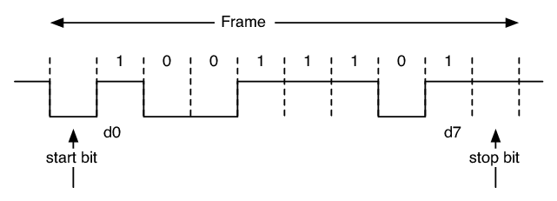
THE UART PROTOCOL
UART, or Universal Asynchronous Receiver/Transmitter, is a common serial communication protocol.
A UART frame, the smallest unit of data transmitted over a UART connection, has the following parameters:
Baud rate – a previously agreed upon rate of data transmission
Number of data bits
Number of parity bits
Number of stop bits
For this lab, we will use a baud rate of 9600 (the most common), 8 data bits (i.e., one byte), no parity bits, and 1 stop bit.
The latter three parameters are denoted 8N1, for 8 data bits, no parity bits, and 1 stop bit.
https://www.researchgate.net/figure/8N1-Data-Transmission_fig1_4253336

Slide 4
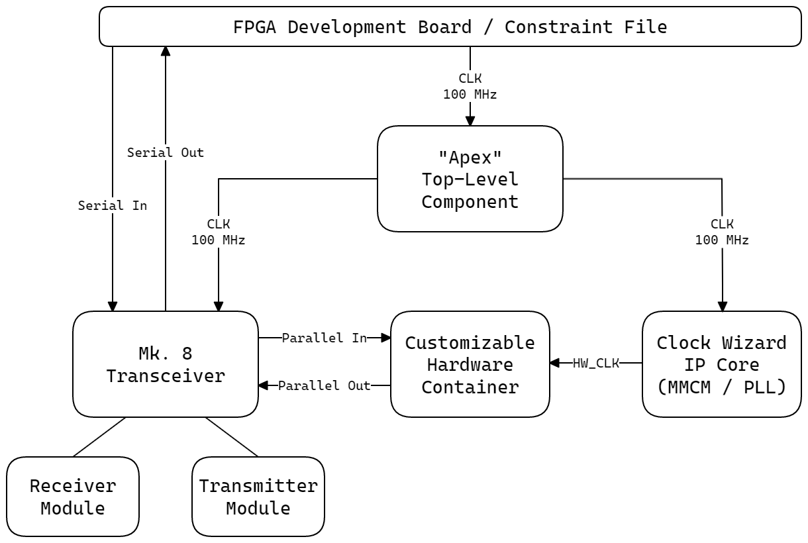
SERIAL TRANSCEIVER
The serial transceiver we will use for this lab is structured as shown on the right.
The FPGA board has dedicated TX (transmitter) and RX (receiver) pins attached to the micro-USB port.
These are routed to the actual transceiver module.
The customizable hardware container will contain the device under test, which in this lab will be a priority encoder, decoder, or barrel shifter.
The clock wizard is an IP (intellectual property) block which provides a cleanly divided clock using the MMCM (mixed-mode clock manager) and PLLs (phase-locked loops) on the FPGA.
https://github.com/ALUminaries/Serial-Transceiver

Slide 5
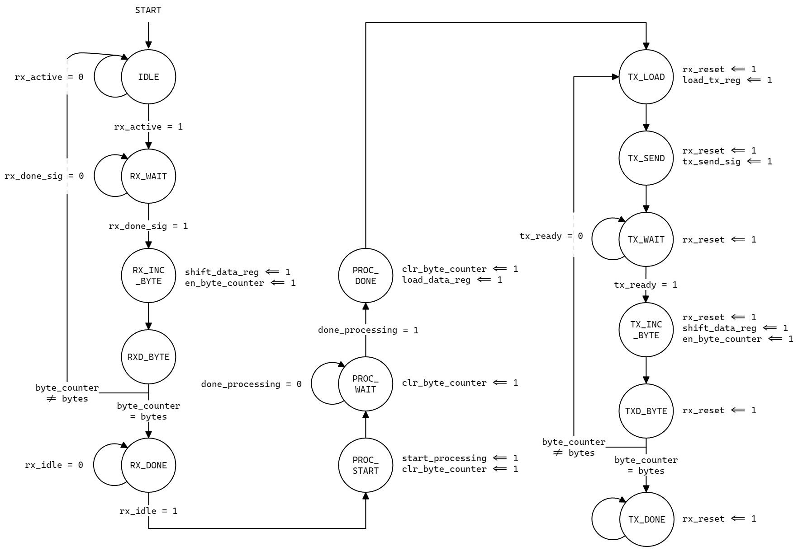
TRANSCEIVER MODULE
The transceiver submodule has three stages:
Receiving
Processing
Transmitting
In the receiving stage, it will wait until a start bit is received, then prepare to receive one byte.
The hardware will accept a predetermined number of bytes before continuing to the processing stage.
During the processing stage, which is typically very fast, the transceiver will transfer the data in parallel to the hardware (ex. 2LPE) and await a done signal from the hardware.
At the transmitting stage, the hardware will loop through and transmit each byte before going idle until reset.

Slide 6
TRANSCEIVER MODULE (CONTINUED)
Note: you do not need to memorize this diagram, only to have an idea of what is happening inside the transceiver.
You will notice that this state machine has only byte-level granularity; it does not handle individual bits.
Each byte is handled by the actual receiver and transmitter submodules.
The transceiver module is more like a manager for both of them.

Slide 7
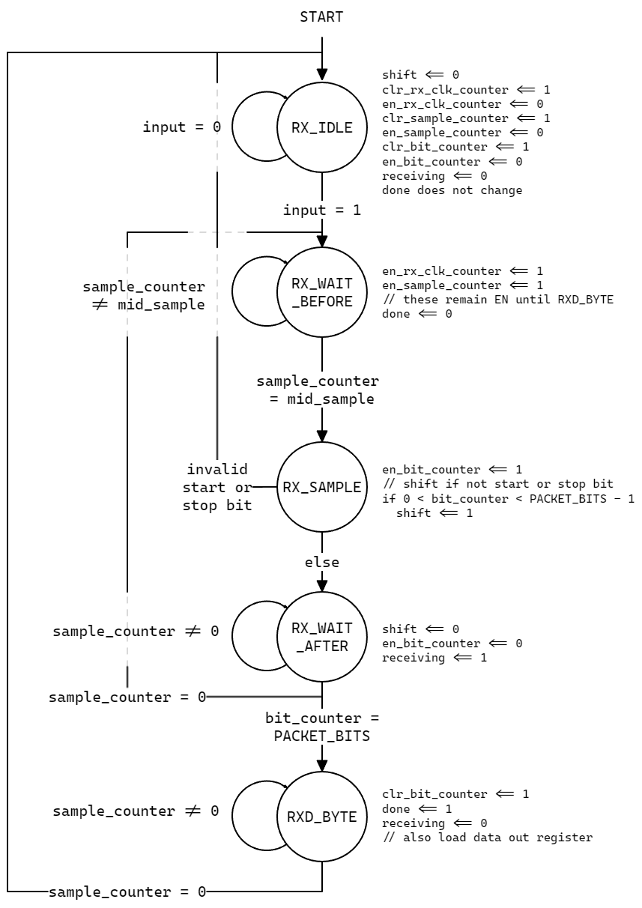
RECEIVER SUBMODULE
The receiver has an input (from the RX pin).
It reads this input four times per second, and samples it at the middle to ensure the result is stable.
This helps to ensure timing, since UART is asynchronous.
Again note that this submodule handles one byte per full loop.

Slide 8
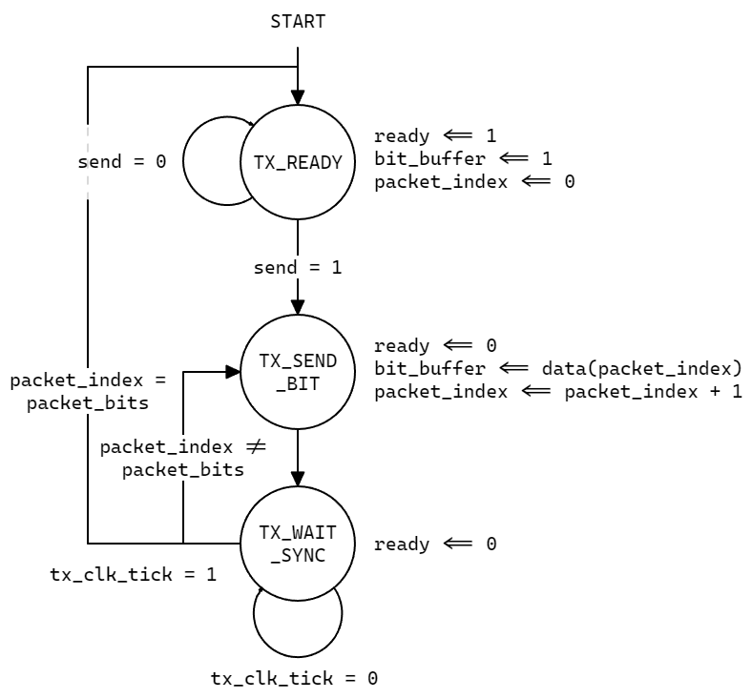
TRANSMITTER SUBMODULE
The transmitter has an output (the TX pin).
It also has a buffer (bit_buffer) which the state machine writes to synchronously.
The output takes the value of this buffer asynchronously.
Like the receiver, this submodule handles one byte per full loop.

